Slide 1
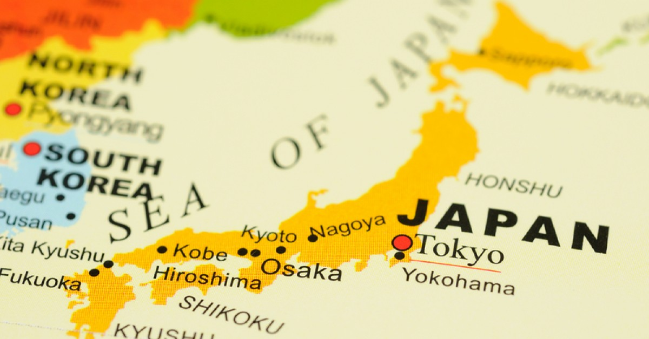
KEY FEATURES AND CULTURE
By Callum Edwards

Slide 2
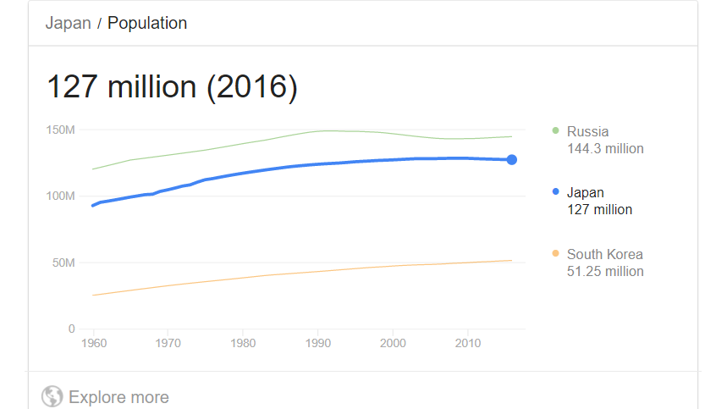
Statistics
Population: 127,366,388
The population of Japan has increased from 92.5 million in 1960 to 127.36 million in 2017

Slide 3
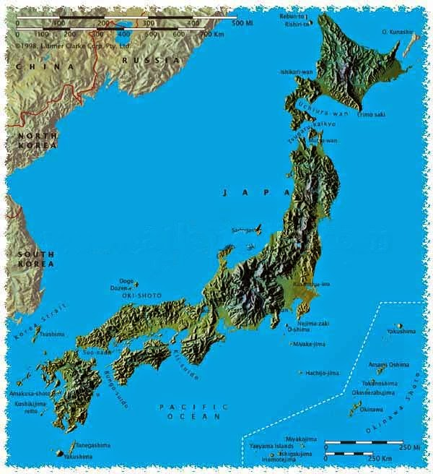
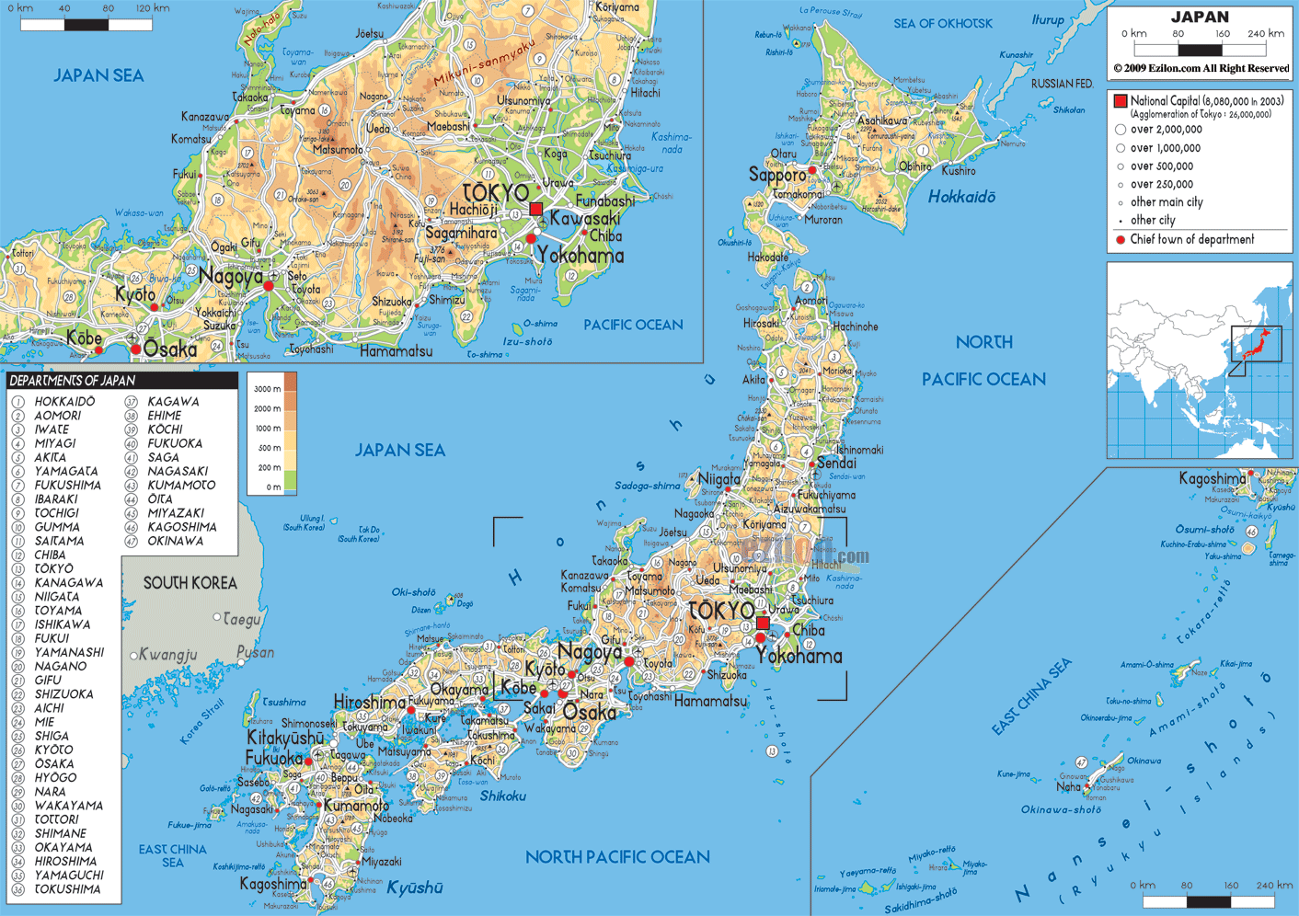
Maps

Slide 4
Food
Rice is a very important meal in Japan culture. The word for meal in Japan is gohan witch refers to steamed rice, though now days the term gohan refers to many different types of meals. Today Japanese people eat a lot of meals from different countries and continents like Europe, North America and Asia. Japanese people eat bread, noodles, and pasta and enjoy a wide variety of meats, fishes, vegetables, and fruits. Sushi, tempura, sukiyaki, and other famous Japanese foods are also popular in Japan. Japanese have many fast-food restaurants that sell hamburgers and fried chicken, which are especially popular with younger people and children. Before eating, Japanese people say "itadakimasu," which is a polite phrase that means "I receive this food." This expresses thanks to whoever worked to make the meal. After eating, they express their thanks by saying "gochiso sama deshita," which literally means “It was quite a feast."

Slide 5
Clothing
The traditional clothing of Japan is the kimono. Kimonos that are generally made of silk, have big sleeves that reach from the shoulders all the way down to the heels. They are tied together with a wide belt that is called an obi. Now Kimonos are only really worn on special occasions such as the Shichi-Go-San festival, weddings, and graduation ceremonies. Compared to Western dress style, the kimono limits a persons movement, and it takes longer to put on properly. In summer a more lightweight informal kimono known as a yukata is worn by children and young adults at occasions like festivals, fireworks displays and other special occasions. In everyday life, though, young people tend to prefer clothing that is easier to move around in like what we would wear in Australia.

Slide 7
Bibliography
http://web-japan.org/kidsweb/explore/housing/index.html

